Slide 1
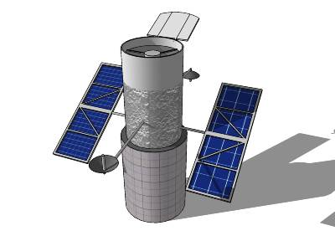
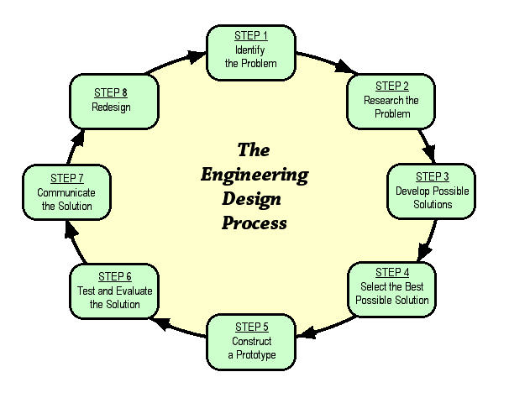
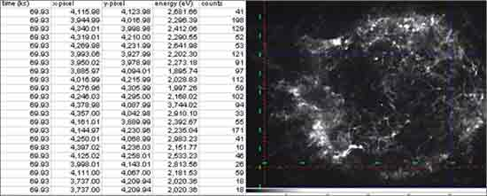
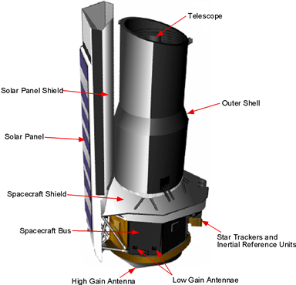
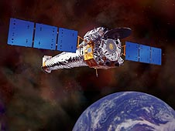
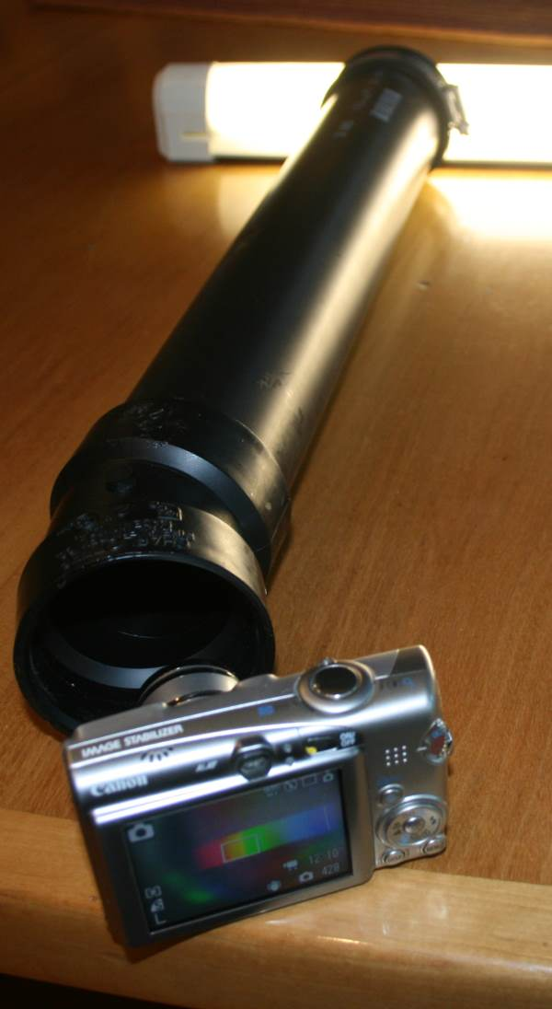
Searching Outer Space
Leslie Garrison
West Boylston Middle High School
Goal / Objective
Students will use the engineering design process to design an orbiting telescope with instrumentation for a specific student-selected objective.
ACTION PLANS
Unit Sequence
Teach basics of satellites and their orbits given gravity.
Introduce EDP and project notebook with a simple design exercise (how to get a penny from one side of table without touching it).
Students complete Hubble Deep Field Academy through stsci.edu to learn about types of objects and uncertainty in evaluating telescope images.
Teach properties of electromagnetic waves and spectra. Student groups build basic spectroscope (like Make magazine #24 p. 58).
Student groups identify the objective for their telescope (search for exoplanets, classify stars / galaxies, locate black hole, etc) and research the type of instrumentation typically used for this work.
Teach key features of space-based telescopes.
Student groups complete research using the virtual activity on James Webb Space Telescope website.
Student groups identify possible space-based telescope designs, sketching individually on paper or on printouts of similar designs.
Teach basics of Trimble Sketch-Up. Students sketch their top design in Sketch-Up.
Teach how Hubble images are processed to form pictures they release using video clip and web lesson.
Student groups will obtain raw images and corresponding processed image from an observatory or satellite of space object they were targeting using similar instrumentation to their satellite.
Student groups will complete Prezi or PowerPoint of their project including an evaluation of their instrumentation selection for the space object they targeted.
STUDENT deliverables
Electronic sketch of orbiting telescope
Prezi or PowerPoint explaining design and instrumentation along with possible telescope views
Project notebook used through EDP
Project definition
Students will utilize the EDP to design a space-based telescope and evaluate the images typically obtained from the selected instrumentation. To accomplish this, students will also be able to
Explain how satellites remain in orbit despite gravity.
Describe the wavelengths of types of electromagnetic radiation and how each type is used in investigating space.
Describe the types of earth and space telescopes and their capabilities.
Explain and use the engineering design process.
Document their progress in a project engineering notebook.
Utilize electronic tools to communicate the results of their projects, specifically Sketch-Up and Prezi or PowerPoint.
Teacher deliverables
Lesson plans for satellite basics, light spectrum, telescopes, and EDP
Technology resources for student use
Materials to build spectroscope
Unprocessed images with a fully processed version for each instrumentation type
Rubric for evaluating each of student deliverables
Performance monitoring
Students’ project notebooks will be monitored weekly for progress against project milestones and understanding of engineering design process.
Electronic drawings will be evaluated as they are completed using a rubric.
Final project will be evaluated against the project rubric incorporating peer grading of participation within groups.

