Slide 1
CAPSULE 2011: Callback January 27th, 2012
Daniel Hogan
Physics Teacher, Littleton High School, Littleton, MA
Original Plan:
Goals/Objectives:
Improve student learning outcomes:
Problem based Learning;
Engineering Design Process;
Common Challenge;
Differentiated rubrics.
Enhance the understanding and use of EDP in other disciplines within the school.
Theme:
“Create a projectile launching machine”

Slide 2
CAPSULE 2011: Callback January 27th, 2012
Actual Progress:
CAPSULE enabled me to kick start a fund raising effort that obtained $30,000 to purchase laptop computers for Solidworks and a 3-D Pinter kit (Makerbot). Setting up infrastructure occupied all my time through Labor Day.
New Engineering Teacher incorporated the use of Solidworks and traditional drawing boards into his curriculum (based on student preference).
“at-risk” students gained new motivation to come to school – spending all their study periods in engineering room learning Solidworks (because they wanted to).
One student decided to design a chess set using Solidworks (fits with New Media teacher’s vision for creating tangible sculpture with Solidworks).
Engineering Club undertook an EDP based assembly and calibration of 3-D Makerbot printer.

Slide 3
Example of “Art meets engineering”
Actual Progress:
One student became particularly interested in designing a chess set in Solidworks to then be printed out using the Makerbot.
This student’s progress has excited the “New Media Arts” teacher to see the possibilities of marrying EDP, Sculpture, and Industrial Design into his curriculum from next year.
We expect that this will result in freshman becoming acquainted with Solidworks – a skill that will be transferable to courses in engineering in their Sophomore, Junior, or Senior years.
Queen from Chess set, rendered in Solidworks

Slide 4
MakerBot
And the Engineering Process
Cameron Jones and Peter Ofsthun

Slide 5
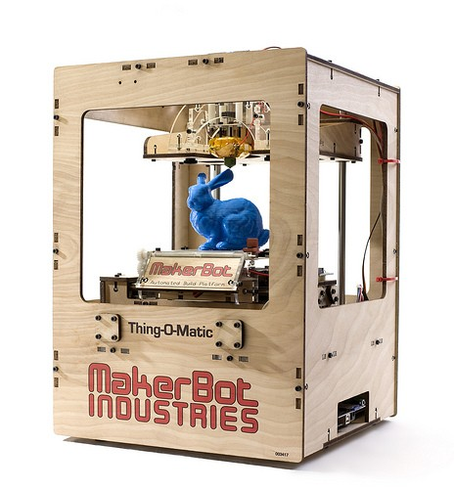
Introduction to Makerbot
Some tech specs on the Thing-O-Matic®: * Build Area: 120 x 120 mm * Build Height: 115 mm * Theoretical XY Resolution of 0.02mm
* Theoretical Z Resolution of 0.005mm
* Additive CNC Process

Slide 6
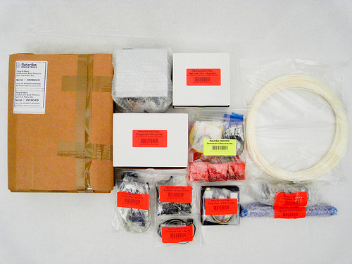
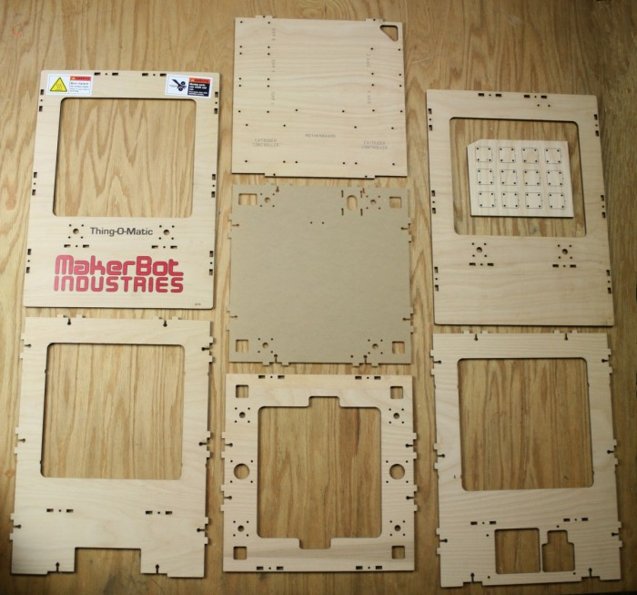
Beginning the Build
Kit Contents: Electronics and Body

Slide 7
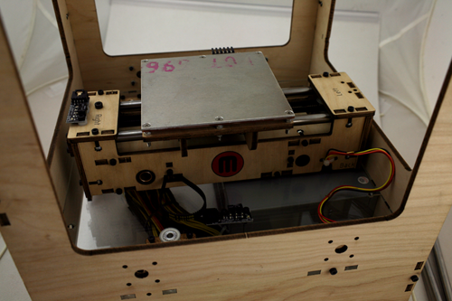
Build Process
Assembled the Kit
Installed Electronics
Connected to the Computer

Slide 8
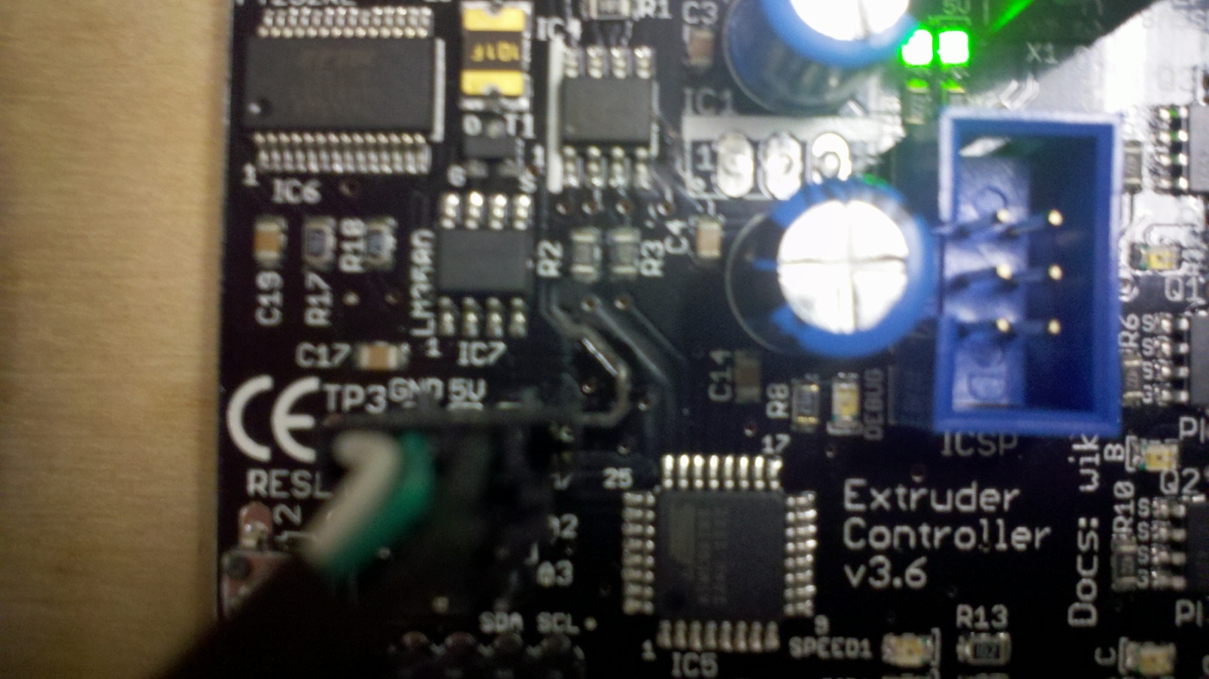
First Challenge
When we turned on the power, smoke wafted from the electronics
Found a short on the extruder control board

Slide 9
Errors in initial calibration
Squashing of Prints
Inconsistent Movements
Filament Jams
Delaminating from Build Surface

Slide 10
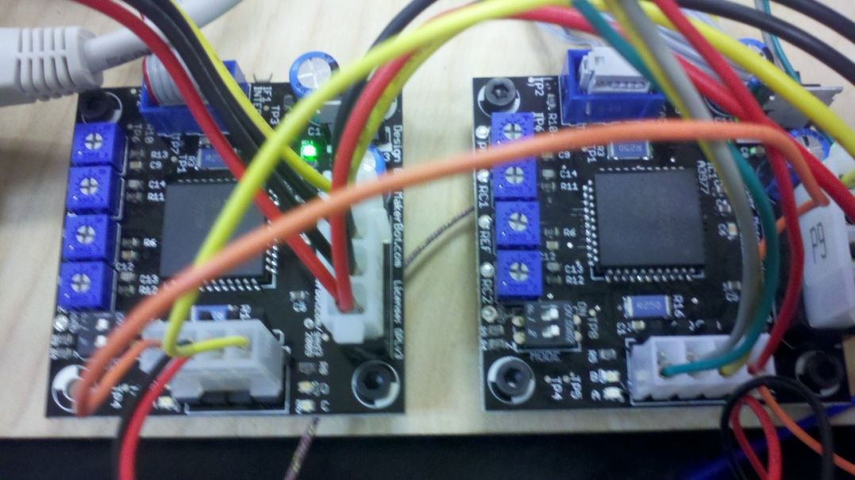
Modifications
First we tackled the inconsistent movements.
Adjusted the potentiometers
Tensioned the Belts

Slide 11
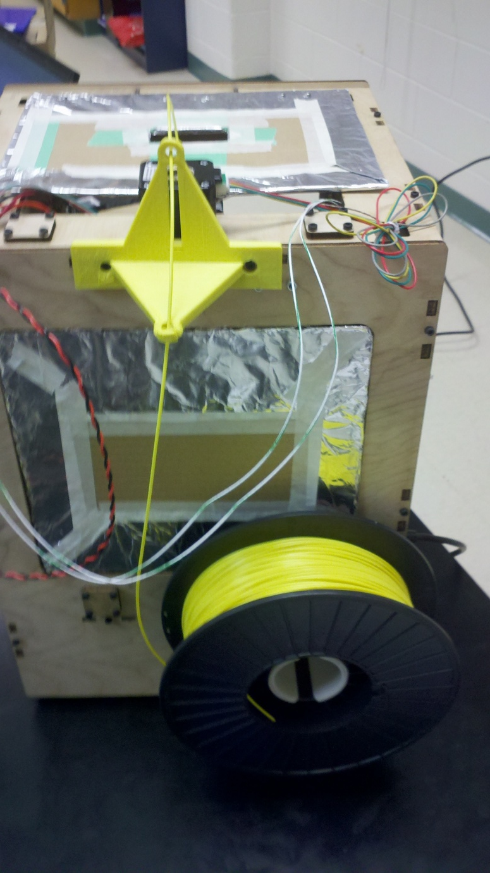
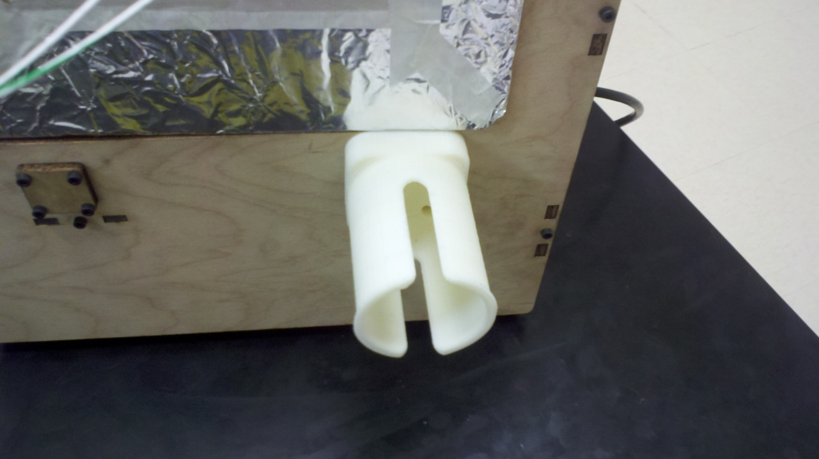
Filament Jams
The initial filament did not have a spool, leading to tangling
Printed parts to hold the filament spool and guide the filament

Slide 12
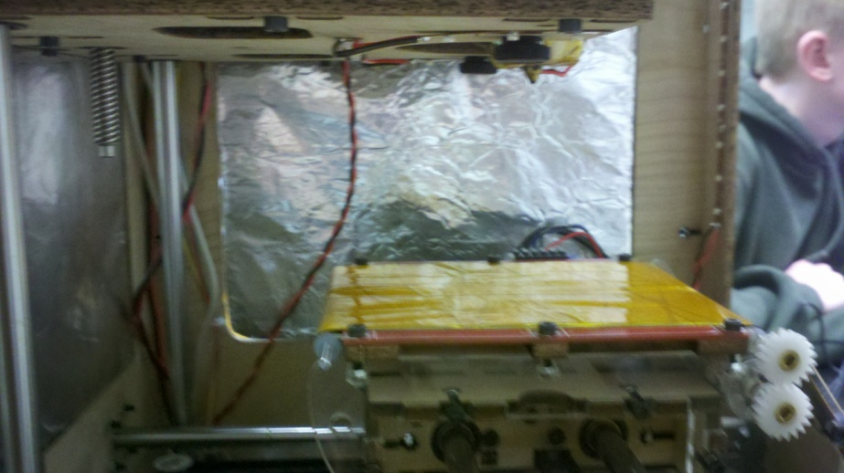
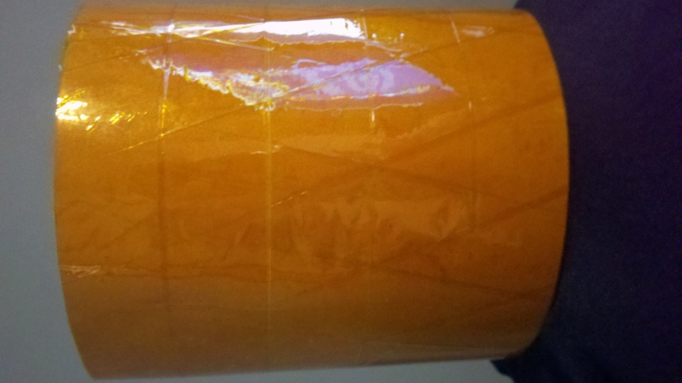
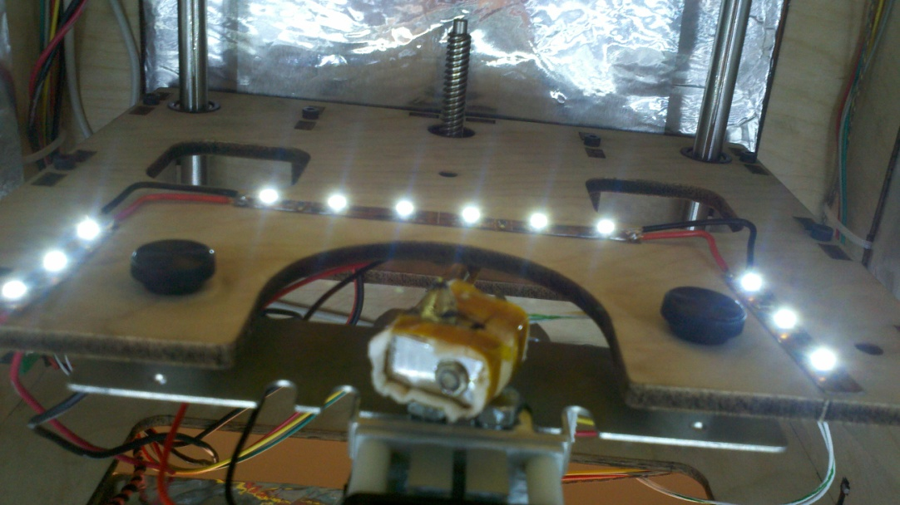
Additional Modifications
When the plastic doesn’t adhere properly, it delaminates from the build surface, causing build errors.
This was the most difficult problem to solve.

Slide 13
