Slide 1




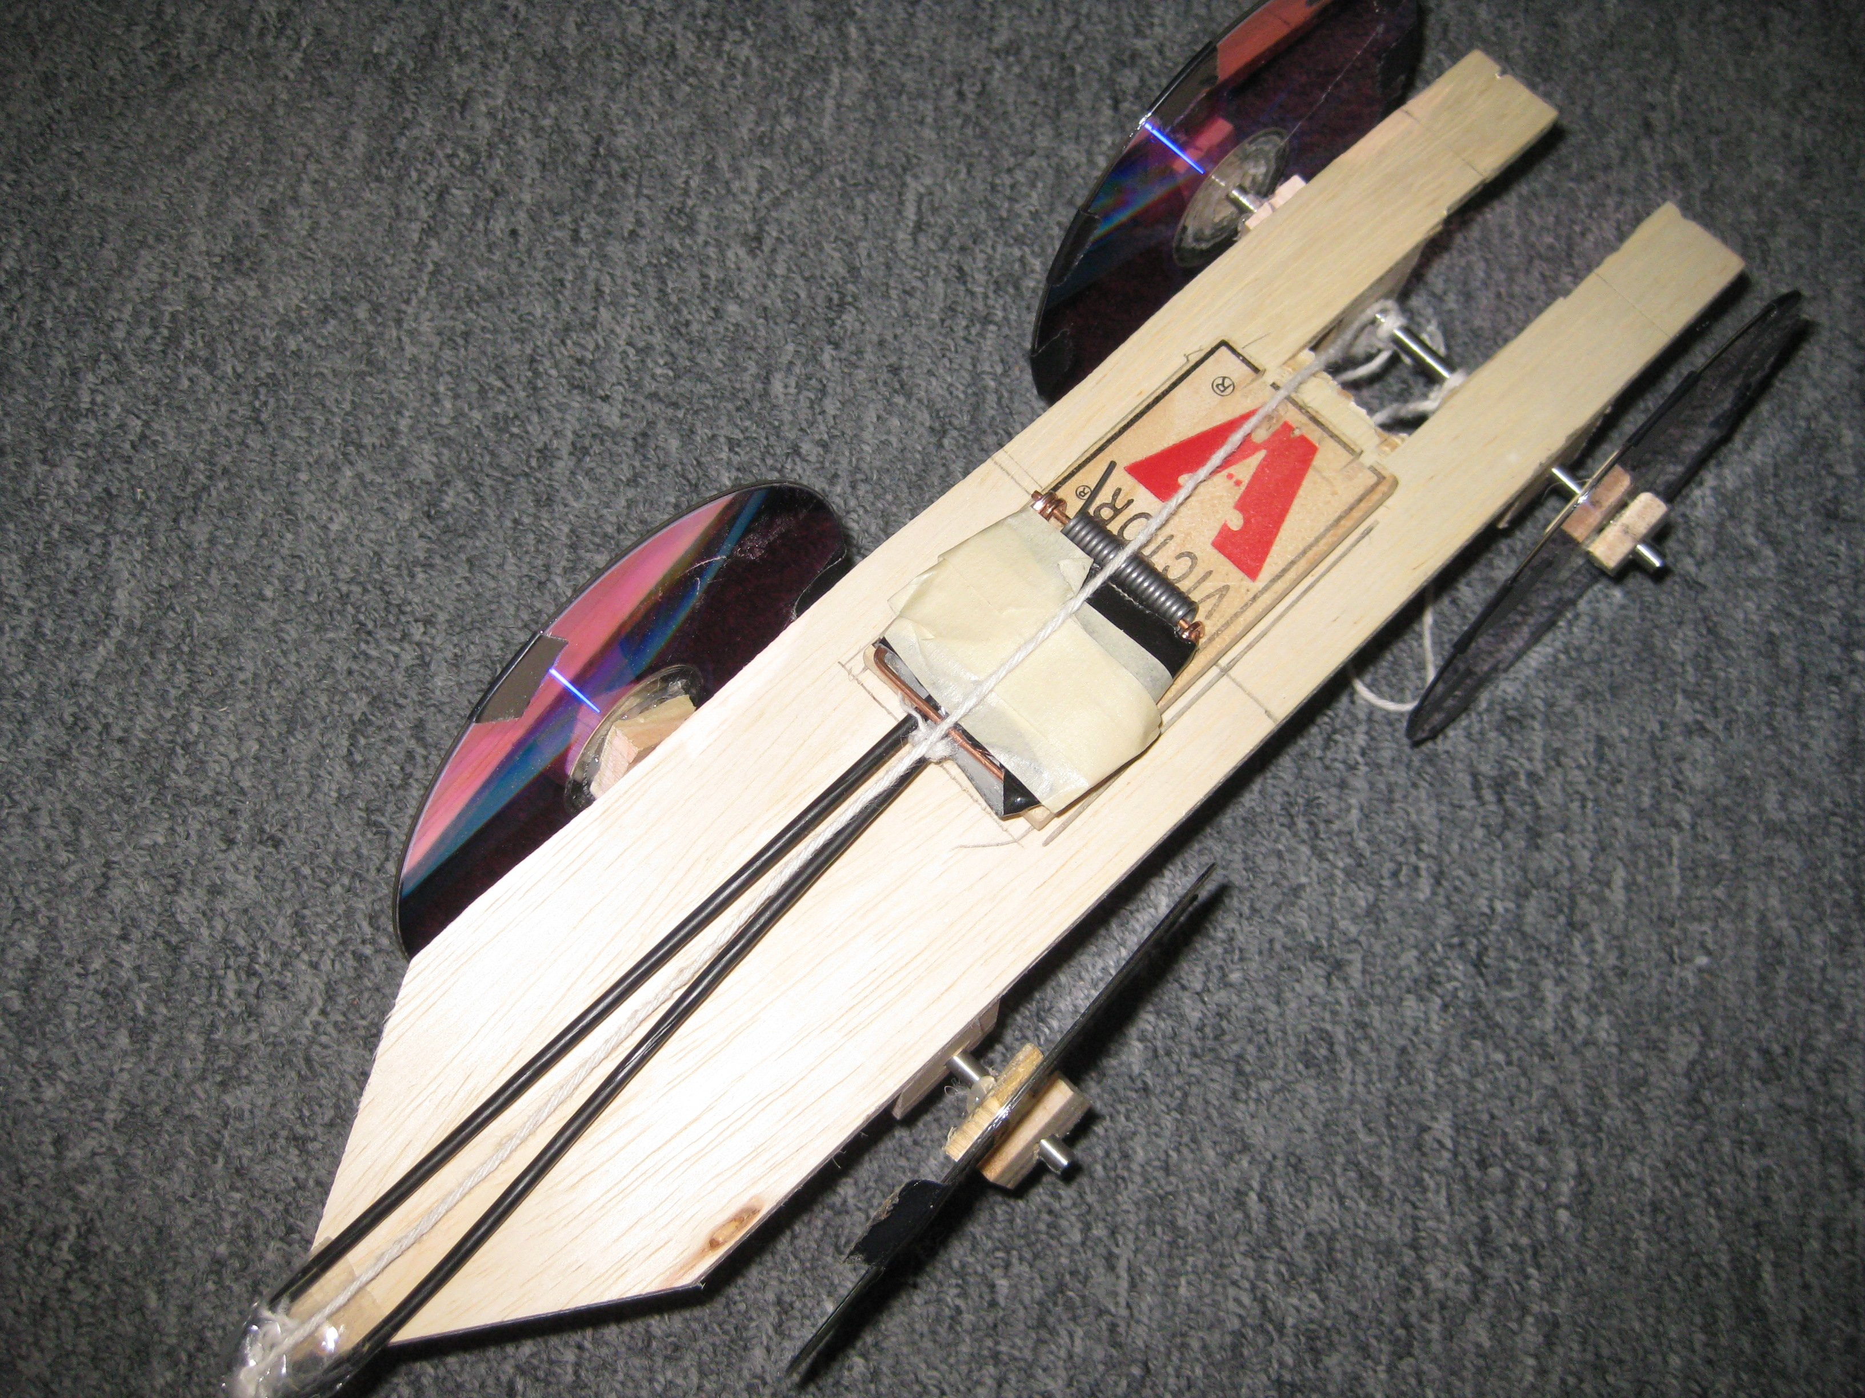
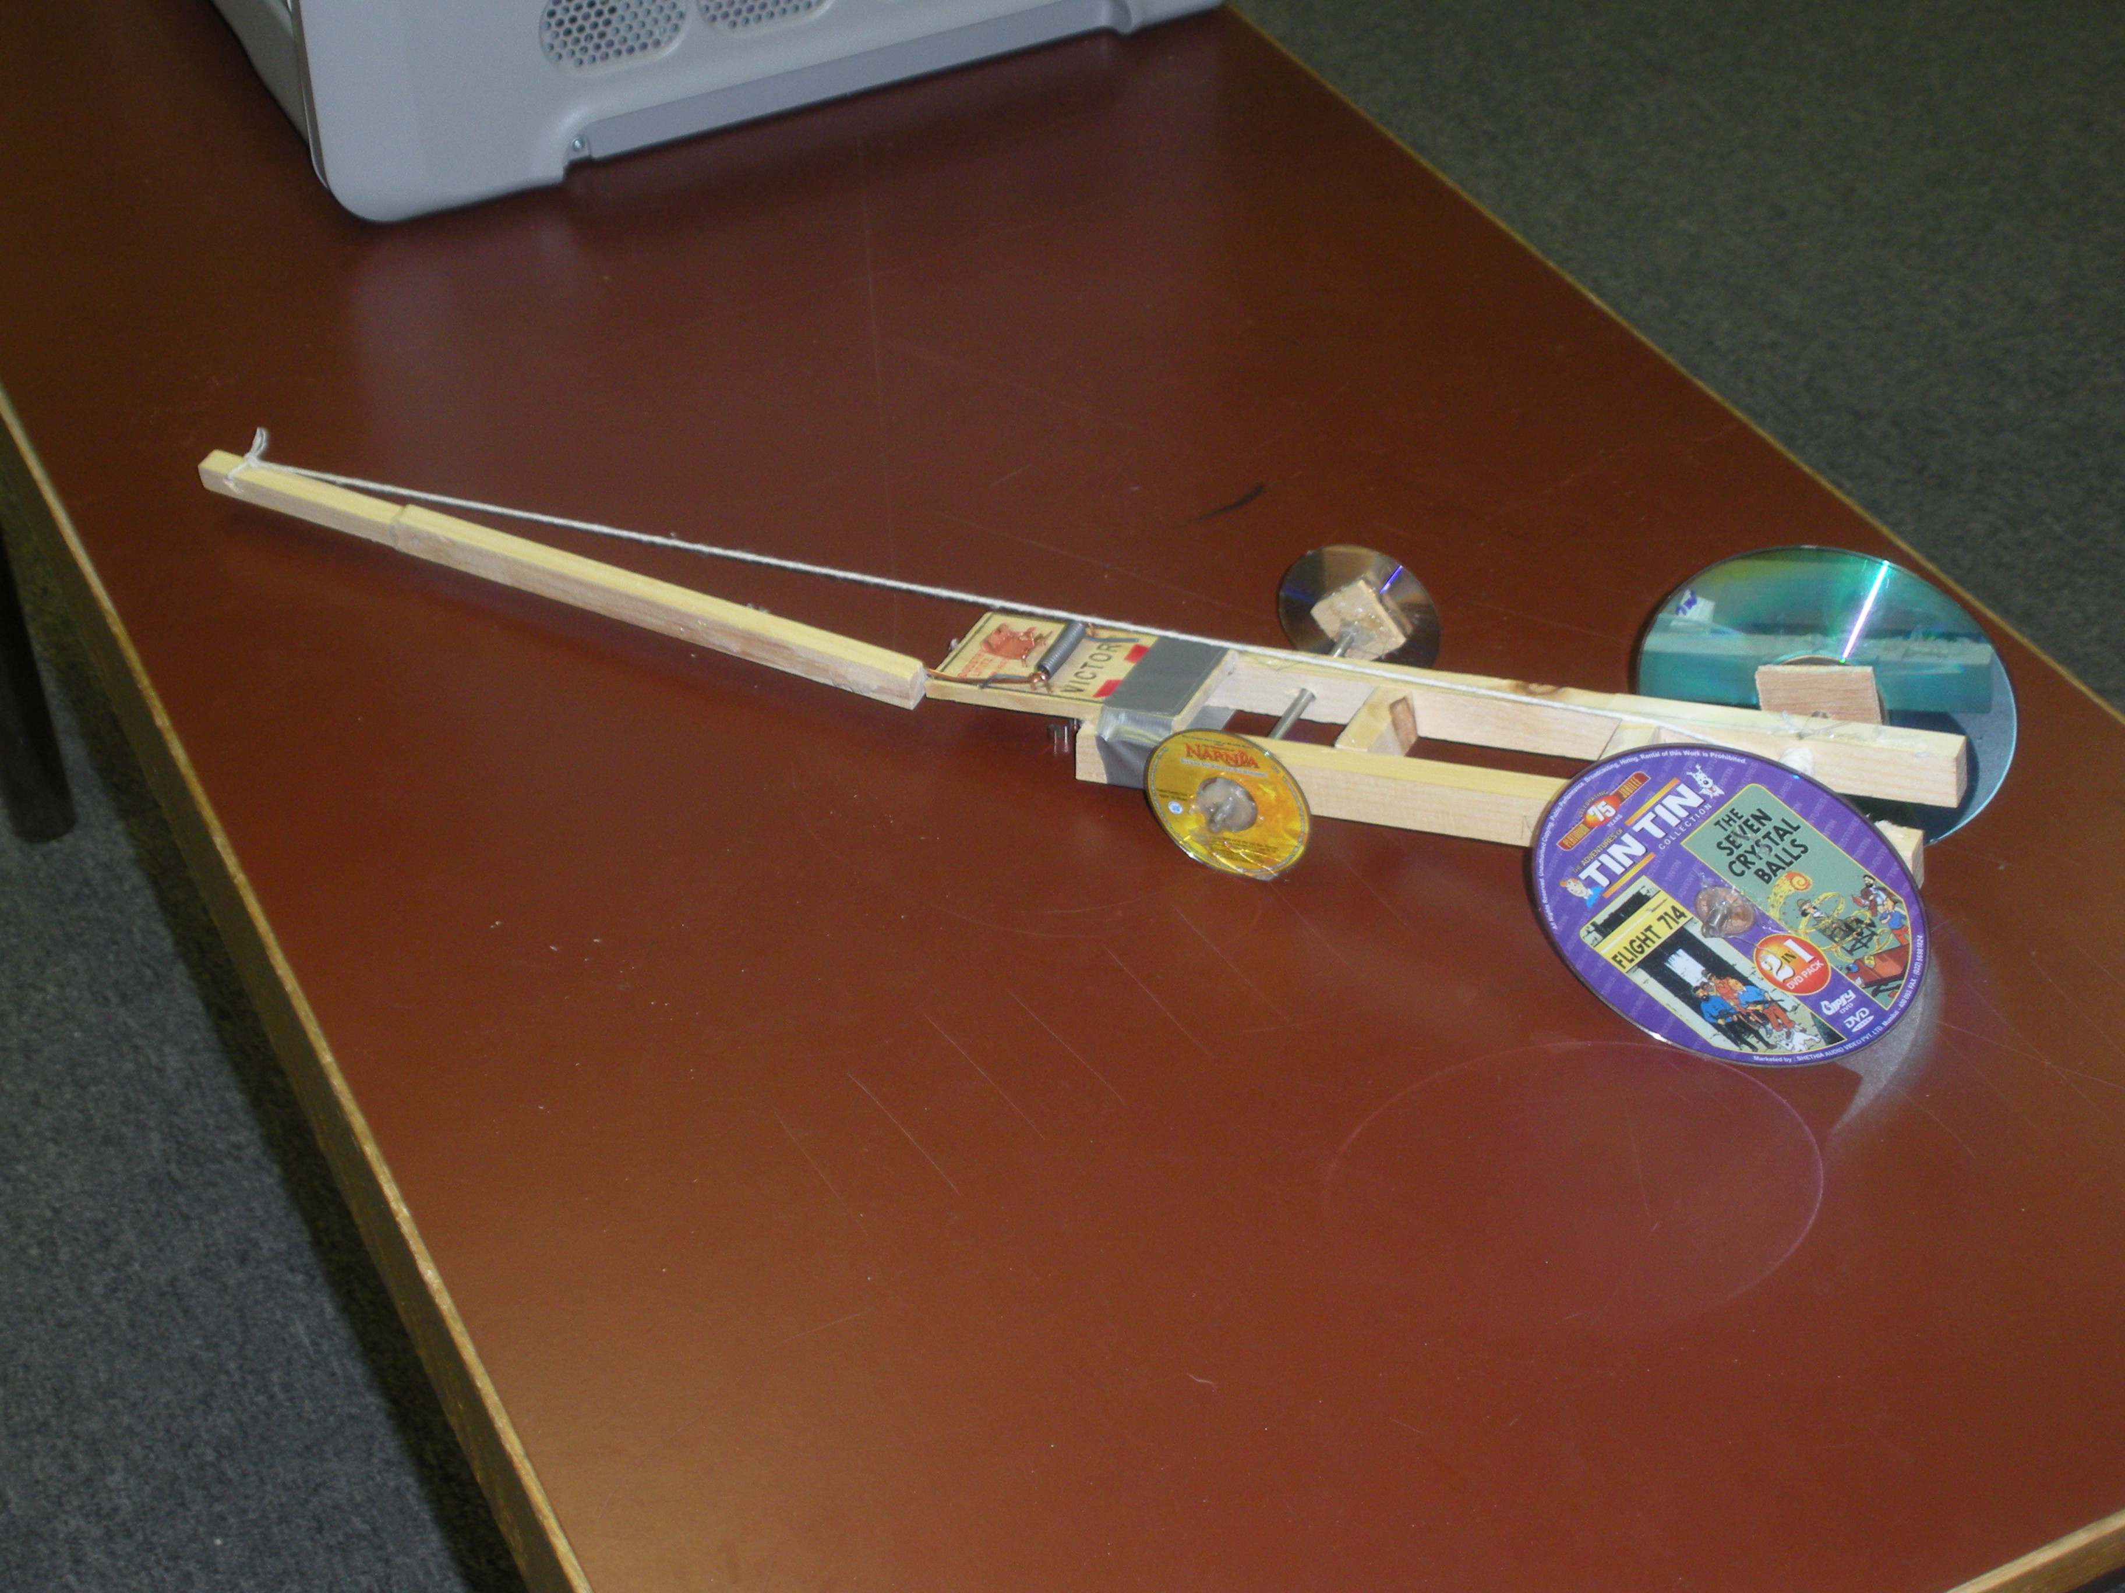
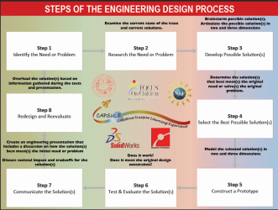
Mousetrap Car Using EDP
Matt Briggs
Goals/objective
Students will construct a distance mousetrap car to explain Newton’s 3 laws of motion.
Students will base format for the project off the Engineering Design Process
Action plan & implementation schedule
Teacher will review Engineering Design Process with students at the beginning of the unit
Teacher will introduce challenge and timeline for due dates of the EDP
Students will research, take notes and design their own distance car
Students will work in groups of three to design prototype and list the materials needed and who’s bringing them
Students will utilize given formulas to confirm car will theoretically work
Students will build parts and assemble car in SolidWorks
Teacher will provide sub-assembly of mousetrap for students
Students will build a distance mousetrap car
Students will redesign/update car for final test
Students will present a PowerPoint presentation to all the classes.
Student deliverables
Students will provide design criteria sheet
Students will provide individual research
Students will provide individual sketch
Students will provide individual pro’s and con’s
Students will provide group prototype sketch
Students will provide initial data on prototype
Students will provide final document showing the steps followed in the EDP
Students will provide SolidWorks prototype model of their car
Students will provide a prototype material list
Students will provide a working mousetrap car
Students will provide prototype pro’s and con’s
Students will provide final design sketch
Students will provide final material list
Students will provide PowerPoint presentation showing relationship between car and physics concepts
Project components
Introduction to the Engineering Design Process
Follow up on working in SolidWorks
Design and build a distance mousetrap car
Redesign car to improve distance
Test physics equations on parts of car
Create and present a group PowerPoint presentation
Project background and introduction
Teacher will review Engineering Design Process
Teacher will review SolidWorks
Teacher will introduce project, rubric and due dates for steps within the EDP
Teacher will make groups of three students
Students will create Google docs to organize materials
Students will present PowerPoint to class to review process and physics concepts
Teacher deliverables
Teacher will provide certain materials: mousetrap, metal rod, wood
Teacher will manipulate materials when safety is in question
Teacher will provide mousetrap drawing in SolidWorks
Teacher will provide lessons for SolidWorks program

