Slide 1





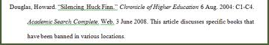
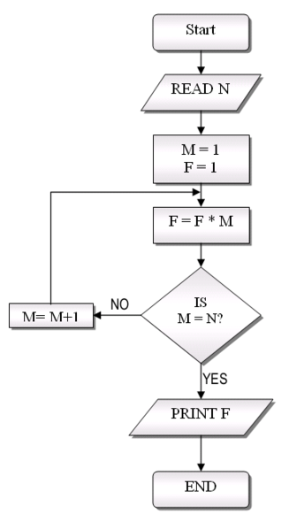
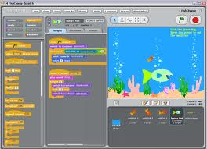
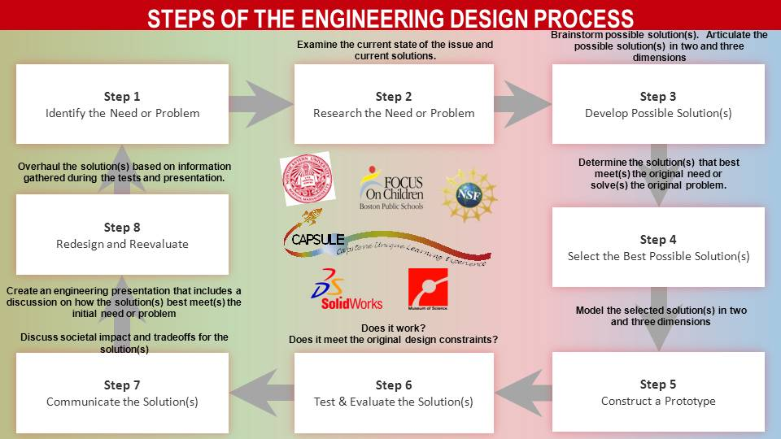
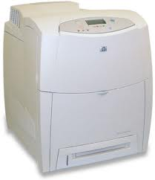
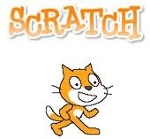
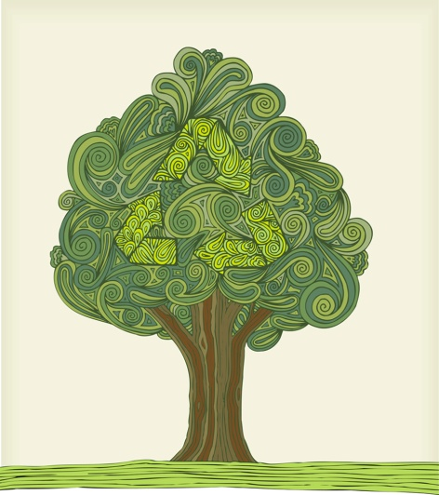
The Printing Problem
Mary Beth Bergh Cape Cod Academy
OBJECTIVEs
Students will use the Engineering Design Process (EDP) as it relates to computer programming to research a problem within their school community, develop a solution for making calculations, and communicate their results to their class.
Students will demonstrate the use of safe and effective Internet research skills and citation of sources.
Students will write a program in Scratch to calculate paper use within the school and communicate their calculations.
ACTION PLANs & Implementation schedule
Problem: Overuse of printing resources within the CCA community
Action Plan #1 – Research, Design solution
Time frame: early fall, as the topics of safe and effective Internet research and proper citation of sources are discussed
Time needed: 2 class periods
Students will:
research how much paper can be made from one tree
calculate how much paper is used in a week at three different student printing centers
write a flow chart for a computer program to calculate, based on data collected above, how much paper and how many trees are used by students in our school in one school year
Action Plan #2 – “Prototype”, Test Solutions, Communicate
Time frame: late fall
Time needed: 5 class periods
Students will:
complete the first 6 Scratch cards as an introduction to Scratch
write a program for calculating paper use based on flow chart
use the EDP to modify program (the “prototype”) as needed
create mini-capstone Scratch project: use Scratch calculation code in combination with other Scratch features of their choice (motion, sound, drawings, images) to communicate calculations
STUDENT DELIVERABLES
Annotated MLA citation for website used for paper production per tree; annotations include search terms
Flow chart for algorithm for calculating paper usage for one year from 3 student printing locations, based on user input to Scratch program
Mini-capstone Scratch project communicating paper use calculations
Project Definition
This project will combine several topics taught in 6th grade Information Literacy and Technology (ILT), including safe Internet research skills, correct MLA citation of sources, introduction to computer programming, effective use of presentation tools, and presentation skills. Students will utilize the EDP, in the context of computer programming, to develop and communicate their solutions to quantifying a community problem, the overuse of printing resources.
Students will use advanced Internet search skills to safely and effectively research facts about trees and paper production
Students will cite Internet sources in proper MLA format with annotations describing search process
Students will use the EDP to develop an algorithm for calculating paper usage from 3 different locations for one week, then expand the calculation for a school year
Students will use Scratch, a drag-and-drop computer programming language, to test their algorithm for calculating student paper usage, modifying their algorithm as needed
Students will use Scratch to present their findings as a mini-capstone
TEACHER DELIVERABLES
Presentations for action plan #1 and #2
Copy of Scratch cards for students
Rubric for grading mini-capstone Scratch project
Plan for future expansion of project
  Year 2: after looking at Year 1 quantification of “The Printing Problem”, students use the EDP to develop, implement, and communicate solutions
  Year 3: after reevaluating Year 2 solutions and paper savings (if any), students use the EDP to redesign solutions

